Slide 1
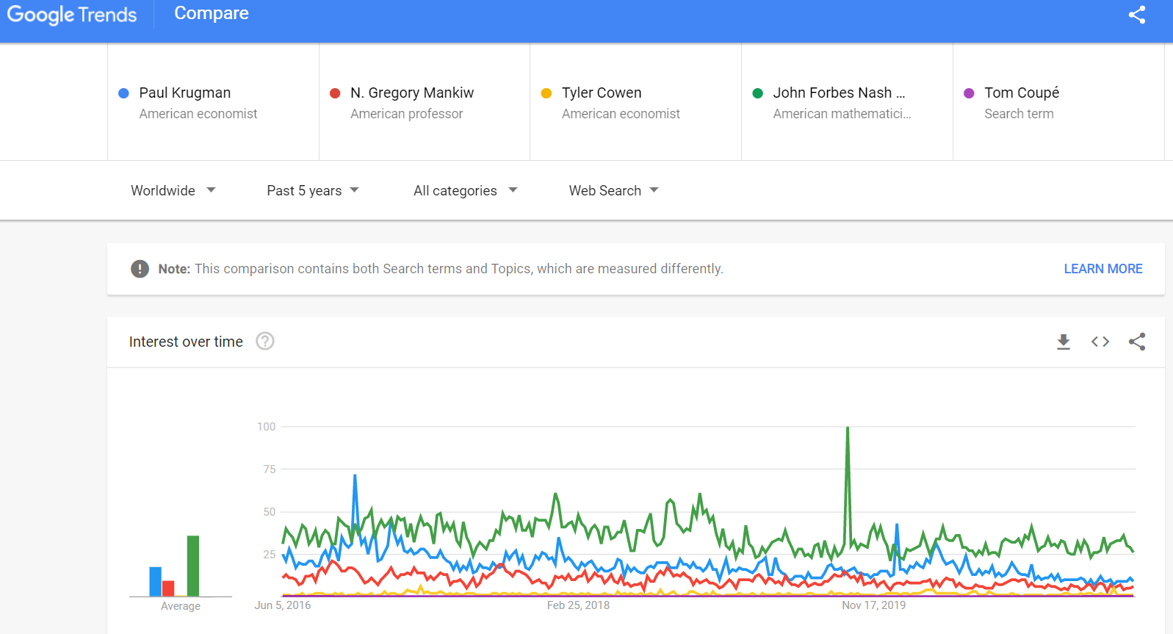
WHO IS THE MOST GOOGLED ECONOMIST?
Motivation: how to measure the impact of academics?
Traditional: citations (impact on academics, f.e. Coupé, 2003)
Here: Google search intensity (impact on whole population!)
How to?
Find list with names of economists (RePEc, Wikipedia, Nobel)
Select those whose searches are aggregated into ‘topics’
Use the Google Trends Compare option
      always keeping the same economist as benchmark
      use average intensity relative to benchmark
      repeat on different days
Findings:
moderate correlation of citations and search intensity
illustrates various ways economists become famous.
Google “Tom Coupe most sought” for the full ranking ☺

